Slide 1
Cerebro spinal fluid
Dr Reshmy K.R
Professor
Dept. of Physiology
SKHMC

Slide 2
A clear, colourless, transparent fluid that circulates through the ventricles of brain, subarachanoid space and central canal of spinalcord.

Slide 3
The fluid contained in the central canal of spinal cord, subarachnoid space and cerebral ventricles which is a part of extra cellular fluid.

Slide 4
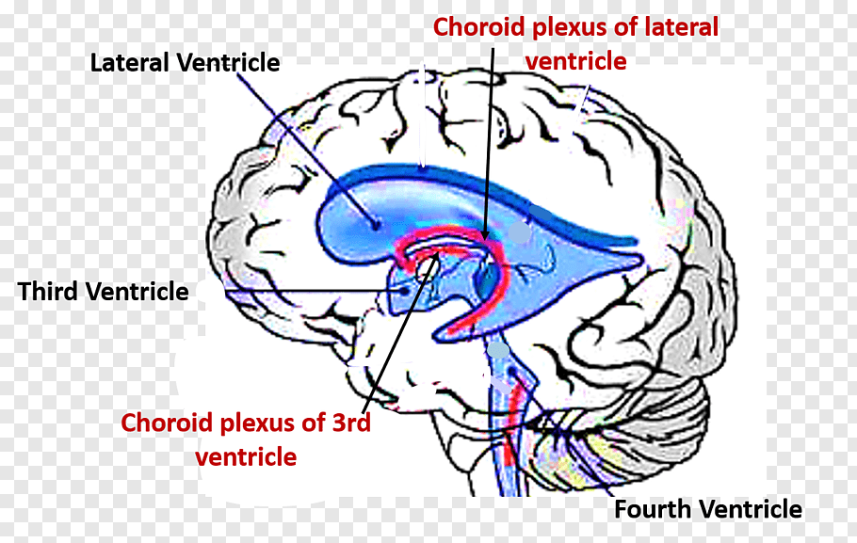
Lumbar CSF pressure = 70-180 mm CSF
Absorption of CSF occurs by bulk flow is proportionate to CSF pressure.
At pressure of 112 mm (normal average): filtration and absorption are equal.
Below pressure of 68 mm CSF, absorption stops.

Slide 5
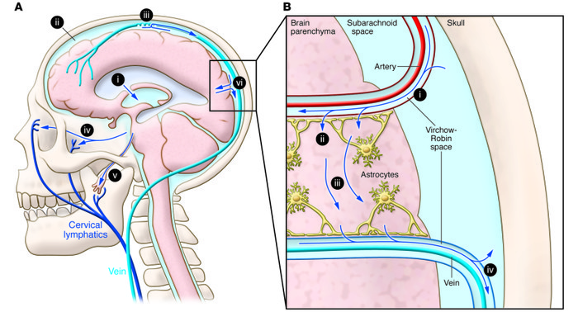
Formation of CSF
CSF is produced by choroid plexus situated within the ventricles , secreted at ciliated cuboidal epithelial cell surfaces of the microvilli into the ventricles
CSF is absorbed by: Arachnoid villi
Other sources of CSF production from capillary ultrafiltrate (Virchow-Robin spaces)
Additionally some produced from metabolic H₂O production

Slide 6
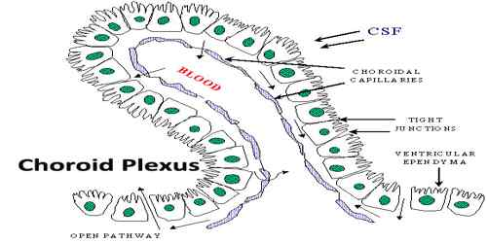
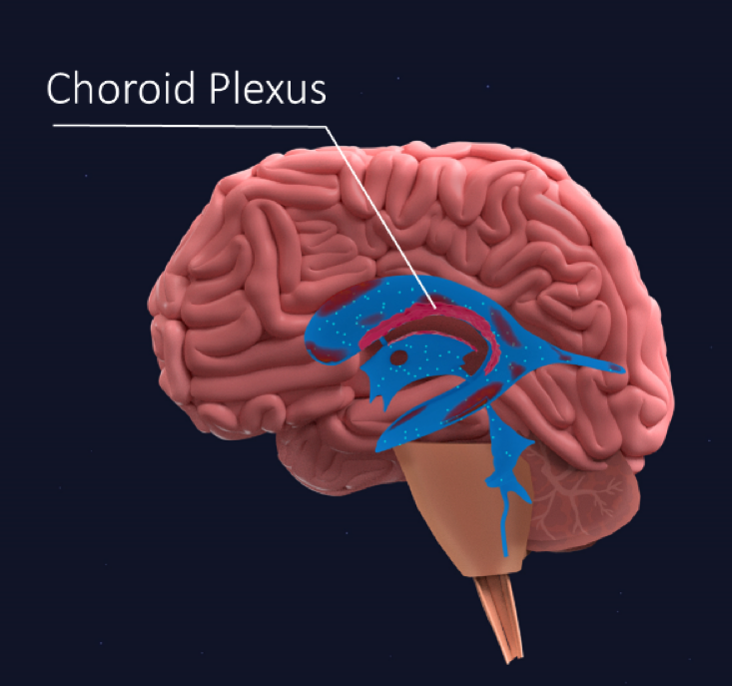
Choroid plexuses are tuft of capillary projections present inside the ventricles & are covered by pia mater and ependymal covering.

Slide 7
Mechanism of formation
CSF is formed by the process of secretion-active transport mechanism
With the expenditure of energy , active transport mechanism is involved in the secretion.
Large amount of CSF is formed in the lateral ventricles

Slide 8
substances affecting the formation of CSF
1. Pilocarpine , ether and extracts of pituitary stimulates the secretion of CSF by stimulating choroid plexus .
Injection of isotonic saline also stimulates formation of CSF
Injection of hypotonic saline causes greater rise in capillary pressure and intracranial pressure and fail in osmotic pressure.
All these factors increase formation of CSF.

Slide 9
Hpertonic saline reduces the formation of CSF and reduces the CSF pressure.
The increased intracranial pressure is reduced by injection of 30 - 35% of Nacl or 50% sucrose.

Slide 10
Properties & Composition of CSF
Clear , colourless ,transparent fluid
Volume = 150 ml, (100 & 200ml)
Rate of production =550 ml/d, 0.3 ml/mt)
so it turns 3.7 times/day.
specific gravity -1.005
Reaction-Alkaline
water -99.13%
solids-0.8%

Slide 11
Substance | CSF | Plasma
Na+ | 147 | 150
K+ | 2.9 | 4.6
HCO3- | 25 | 24.8
PCO2 | 50 | 39.5
pH | 7.33 | 7.4
Osmolality Glucose | 289 64 | 289 100

Slide 12
Organic solids
Inorgainc solids
Proteins
Aminoacids
Sugar
Cholesterol
Urea
Uric acid
Creatinine
Na⁺
K⁺
Mg₂⁺
Cl⁻
PO₄
HCO₃⁻
SO₄²⁻
SO₄²⁻
It contains more amount of Na than K

Slide 13
CSF contains 6 lymphocytes /cumm
the CSF secreted by ventricles does not contains any cell
the lymphocytes are added when it flows in the spinal cord

Slide 14
The secretion of fluid by the choroid plexus depends on the active Na+-transport across the cells into the CSF.
The electrical gradient pulls along Cl-, and both ions drag water by osmosis.
The CSF has lower [K+], [glucose], and much lower [protein] than blood plasma, and higher concentrations of Na+ and Cl-.
The production of CSF in the choroid plexuses is an active secretory process, and not directly dependent on the arterial blood pressure.

Slide 15
Circulation of CSF

Slide 18
Absorbtion of CSF
Eliminated by being absorbed into the Arachnoid villi
Dural sinus ,spinal veins
Jugular system
small amount-perineural spaces into cervical lymphatics , perivascular spaces

Slide 20
CSF is reabsorbed into the blood of the venous sinuses via the arachnoidal villi.
The absorption here is directly related to the CSF pressure in the cranial cavity.
perineural spaces
Lymphatics/cribiform plate
perivascular spaces
Transependymal flow

Slide 21
Mechanism of absorption is by pressure gradient between hydrostatic pressure in the subarachanoid space fluid and the pressure that exists in the dural sinus blood.
the collodial substances pass slowly and crystalloids rapidly
normally about 500 ml of CSF is formed every day and an equal amount is absorbed.

Slide 22
Route and Absorption of CSF
Arachnoid villi
-microscopic one-way valves (modified pia and arachnoid) that penetrate the meningeal dural layer that lines the sinuses
- arachnoid villi reside within the sinuses (especially the superior sagittal sinus).
Clumps of arachnoid villi -arachnoid granulations (macroscopic)

Slide 23
Route and Absorption of CSF
Hydrostatic pressure in subarachnoid space > pressure in dural sinuses
Typical hydrostatic values of CSF are 150 mm H₂O (11 mm Hg) in subarachnoid space vs. about 70 mm H₂O (5 mm Hg) in dural sinuses.
Arach. villi are one-way valves that open when the hydrostatic pressure of CSF in the subarachnoid space is about 1.5 mm Hg greater than venous hydrostatic pressure in the dural sinuses (i.e., passive process).

Slide 24
coughing and crying increases the pressure by decreasing the absorption
compression of internal jugular vein also raises the CSF pressure

Slide 25
Functions of CSF
1.Protective function:
The brain is supported within the arachnoid by the blood vessels , nerve roots and the arcahnoid trabaculae.
In air brain weight is1400 g, but in its water bath of CSF , brain weight -50 g, making it suspended effectively.
When the head receives a blow, the arachnoid slides on the dura and the brain moves, but its motion is gently checked by the CSF cushion and by the arachnoid trabaculae.
Removal of CSF during lumbar puncture can cause severe headache

Slide 26
CSF acts as a fluid buffer and protects the brain from shock
In severe blow to head---countercoup injury (Brain strikes against the skull bones at a point opposite to the point where the blow was applied).
Brain floats in CSF, since the sp. gravity of brain and CSF is more or less same.
-Acts like a cushion and prevents the movement of brain against the skull bone and there by prevents damage of brain.

Slide 27
2.Regulates the volume of cranial contents
--if the volume of cranial contents increases in cerebral haemorrhage and in brain tumors,
--Increase in cranial content volume is prevented by greater absorption of CSF to give space for the cranial contents.

Slide 28
3.Medium through which many substances -nutritive substances and waste materials are interchanged between the blood and brain tissues.
-Distribution of peptides, hormones, neuroendocrine factors and other nutrients and essential substances to cells of the body,
-Wash away waste products.

Slide 29
4.Cardiovascular dynamics are also affected by CSF pressure, as the flow of blood must be tightly regulated within the brain to assure consistent brain oxygenation.

Slide 30
Collection of CSF
Cisternal puncture --- passing a needle between the occipital bone and atlas so that it enters the cisterna magna
lumbar puncture ----subarachnoid space in the lumbar region between the 3 ^{rd} & 4 ^{th} lumbar spines.

Slide 31
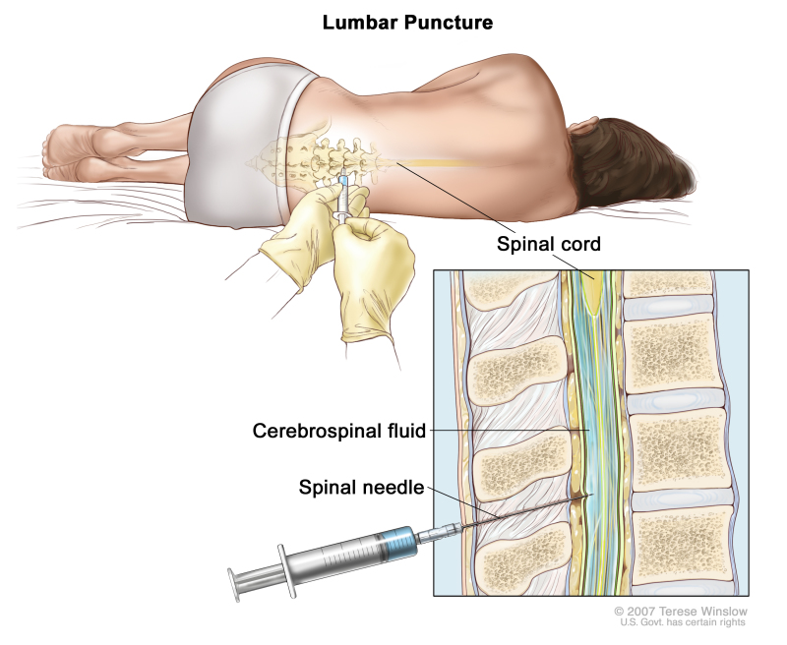
Lumbar puncture
Bodyposture- the reclining body is bent forward, so as to flex the vertebral column as far as possible.
the body is brought near the edge of a table.
the highest point of iliac crest is determined by palpation.
A line is drawn on the back of the subject by joining the highest points of iliac crest of both sides.
Opposite to midplane this line crosses the fourth lumbar space

Slide 32
the third lumbar spine is also palpated.
the needle is introduced into the subarachanoid space by passing through soft tissue space between the two spines.

Slide 33
Reason for selecting the site for L.P
Spinal cord will not be injured , as it terminates below the lower border of the first lumbar vertebra.
Cauda equina may be damaged, but it is regenerated.
subarachanoid space is wider in this site,- the pia matter is reduced very much

Slide 34
Uses of L.P
1.Collecting CSF for diagnostic purposes
2. Injecting drugs for spinal anaesthhesia, analgesia and chemotherapy.
3. Measuring the pressure exerted by CSF

Slide 35
Blood-brain barrier (BBB)
Neuro protective structure that prevents the entry of many substances and pathogens into the brain tissue from blood
Hypothetical barrier which prevents the diffusion of some substances into the brain tissue into the capillary
Exist in the capillary membrane of all parts of the brain except in some areas of hypothalamus

Slide 36
Blood-brain barrier (BBB)
A specialized system of capillary endothelial cells that protects the brain from harmful substances in the blood stream, while supplying the brain with the required nutrients for proper function.
Formed by the nonfenestrated capillaries and to much lesser degree, the astrocytic foot processes—keeps out most macromolecules

Slide 37
It is formed by the tight junctions between capillary endothelial cells of the brain and between epithelial cells in the choroid plexus.
This effectively prevents proteins from entering the brain in adults and slow the penetration of smaller molecules.
Mechanisms of transport:
Bulk flow.
Carrier mediated transfer
Vesicular transport.

Slide 38
Molecules pass easily:H₂O, CO₂, O₂, lipid-soluble free forms of steroid hormones.
Molecules not pass: proteins, polypeptides.
Slow penetration: H⁺, HCO₃⁻
Glucose : its passive penetration is slow, but is transported across brain capillaries by GLUT₁

Slide 39
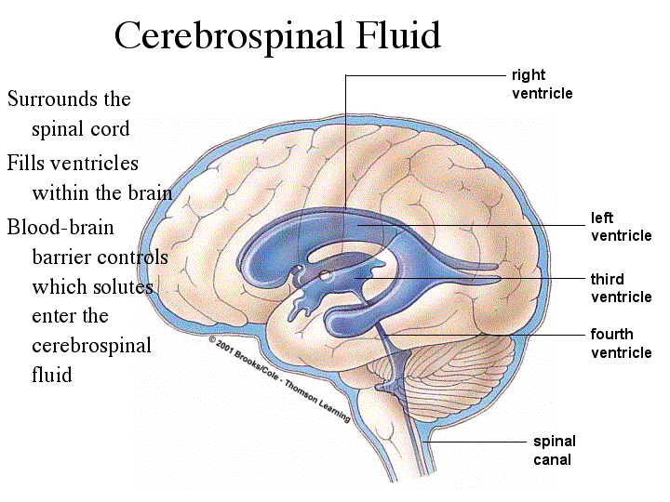

Slide 40
Functions of BBB
Maintains the constancy of the environment of the neurons in the CNS.
Protection of the brain from endogenous and exogenous toxins - prevents potentially harmful chemical substances - provide healthy environment for the nerve cells of the brain
Prevent escape of the neurotransmitters into the general circulation.
Acts as mechanical barrier and transport mechanisms
Permit metabolic and essential materials into the brain tissues

Slide 41
Blood CSF Barrier
The barrier between blood and the CFS that exists at the choroid plexus
Function - similar to that of BBB
It does not allow the movement of many substances from the blood to CFS
It allows the movement of those substances which are allotted by BBB

Slide 42
Development of BBB
The tight junctions in the endothelial cells of brain capillaries are responsible for BBB
In capillaries of other organs, adjacent endothelial cells leave the cleft called fenestra which allows transcytosis of several substances through endothelial cells.
The endothelial cells fuse with each other by tight junctions - fenestra absent in brain.

Slide 43
Tight Junction
Formed between endothelial cells of the capillaries at childhood
Cytoplasmic foot processes of astrocytes develop around capillaries, reinforce the barrier
Astrocytes develop the vasculature completely
Pericytes - important cellular constituent of BBB
- Important role in formation and maintanence of tight junction, structural stability of the barrier
- Pericytes function as macrophages - role in defence

Slide 44
Substances which can pass through BBB
Substances which cannot pass through BBB
Pennicilin
Catecholamine
Dopamine
Injurious chemical substances
Bacteria
Bile pigment, barrier is not well developed in infants, bile pigments enter the brain tissues
kernicterus - damage to basal ganglia during jaundice in infants
Oxygen
Carbondioxide
Water
Glucose
Amino acids
Electrolyes
Sulfonamindes
Tetracycline
L-dopa
Lipid soluble drugs
Lipid soluble anesthetic gases - ether and NO

Slide 45
Hydrocephalus
Abnormal accumulation of CFS in the skull, associated with the enlargement of the head is called hydrocephalus
During obstruction of any foramen through which CFS escapes the ventricular cavity dialates - internal hydrocephalus (non-communicating)

Slide 46
Arachnoid villi are blocked - external or communicating hydrocephalus
Hydrocephalus along with increased intracranial pressure - headache and vomiting
Atrophy of brain, mental weakness and convulsions - in severe condition

Slide 47
References https://www.webmedcentral.com/article_view/3382 https://in.pinterest.com/pin/257057091210675551/
THANK YOU

